Slide 1



Internship at
KAZ Software Limited
Sajjad Hossain
Reg No: 2018831032
Department of Software Engineering
Institute of Information and Communication Technology
Shahjalal University of Science and Technology, Sylhet

Slide 2
Kaz Software Limited
A custom software company in Bangladesh started as a start-up software outsourcing company in 2004
Notes:
They became a Bangladesh limited company in 2005 and have been growing every year. They find technical solutions for their clients. Typically this would mean they are building software products for them, but sometime they would be doing something completely different like researching business data or setting up clients’ firewall.

Slide 3
About Kaz
Location: 35/5, Shantinagar, Dhaka-1217
19 years since establishment
Served more than 100 companies
Completed more than 150 projects
More than 80 employees working currently

Slide 4
Services
Ideation, Graphics and Interaction Design
Software Development
Software Quality Assurance
Data, Content and Research

Slide 5
Internship Activities

Slide 6
Projects
Worked on two client project
Hakma
Band Score 9

Slide 7
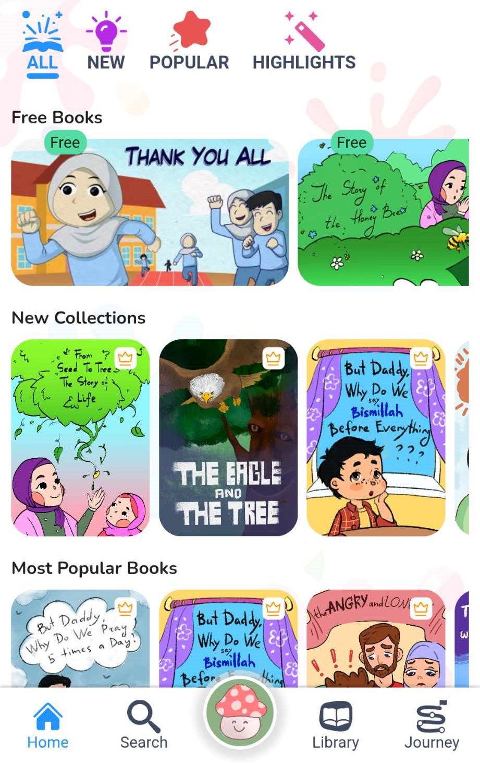
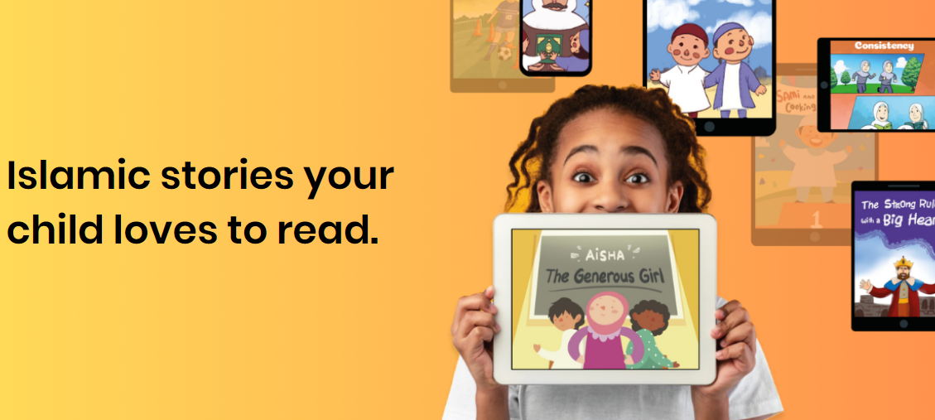
Hakma
A mobile application for children and students to learn about Hadiths through various stories, games and quizzes.

Slide 8
Features
User
Read stories and learn about hadiths.
Give quiz after finishing the hadiths
Purchase premium books and read promotional books for free
Can give feedback for each book
Schools
Buy subscription for monthly and annually
create class and students.
See Students Progress

Slide 9











Tools and Technologies

Slide 10
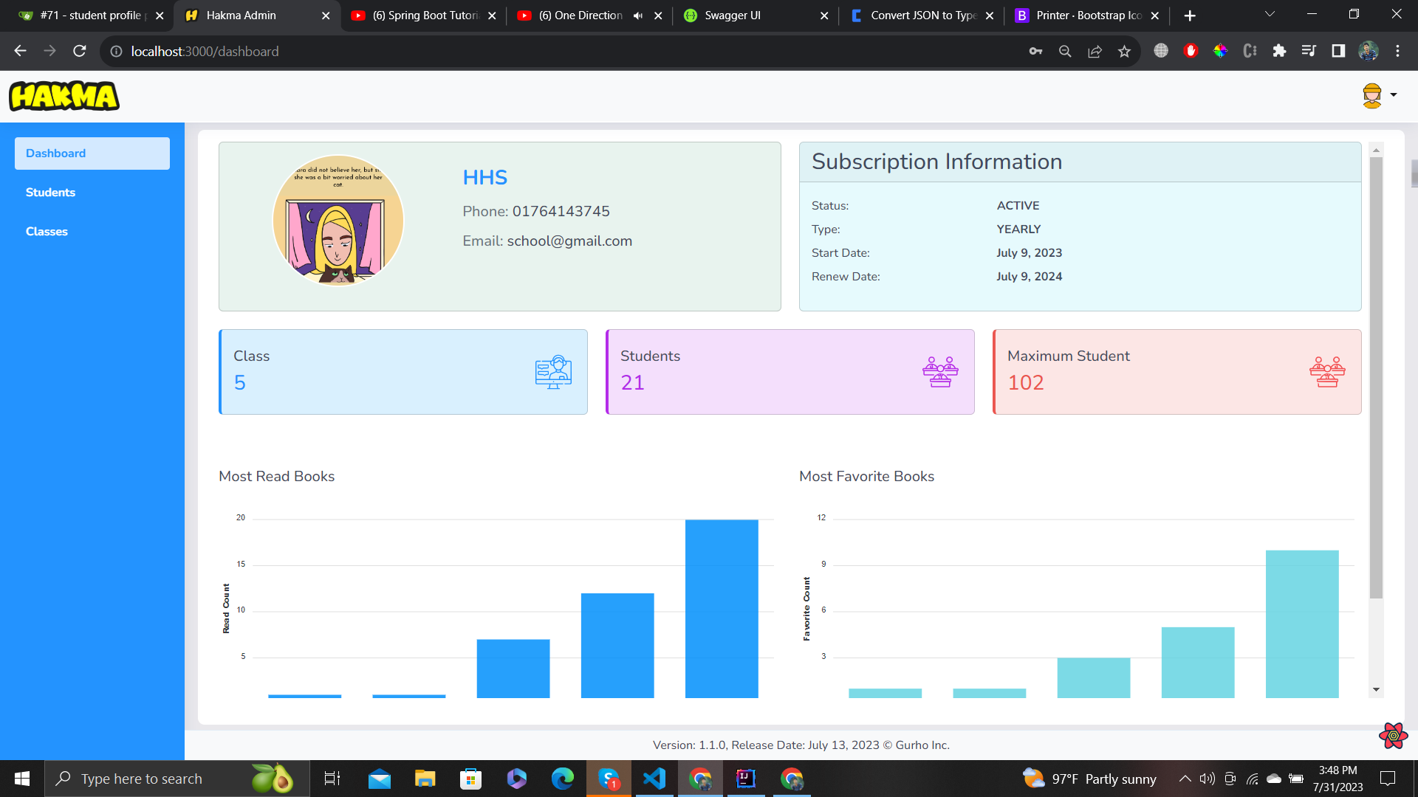
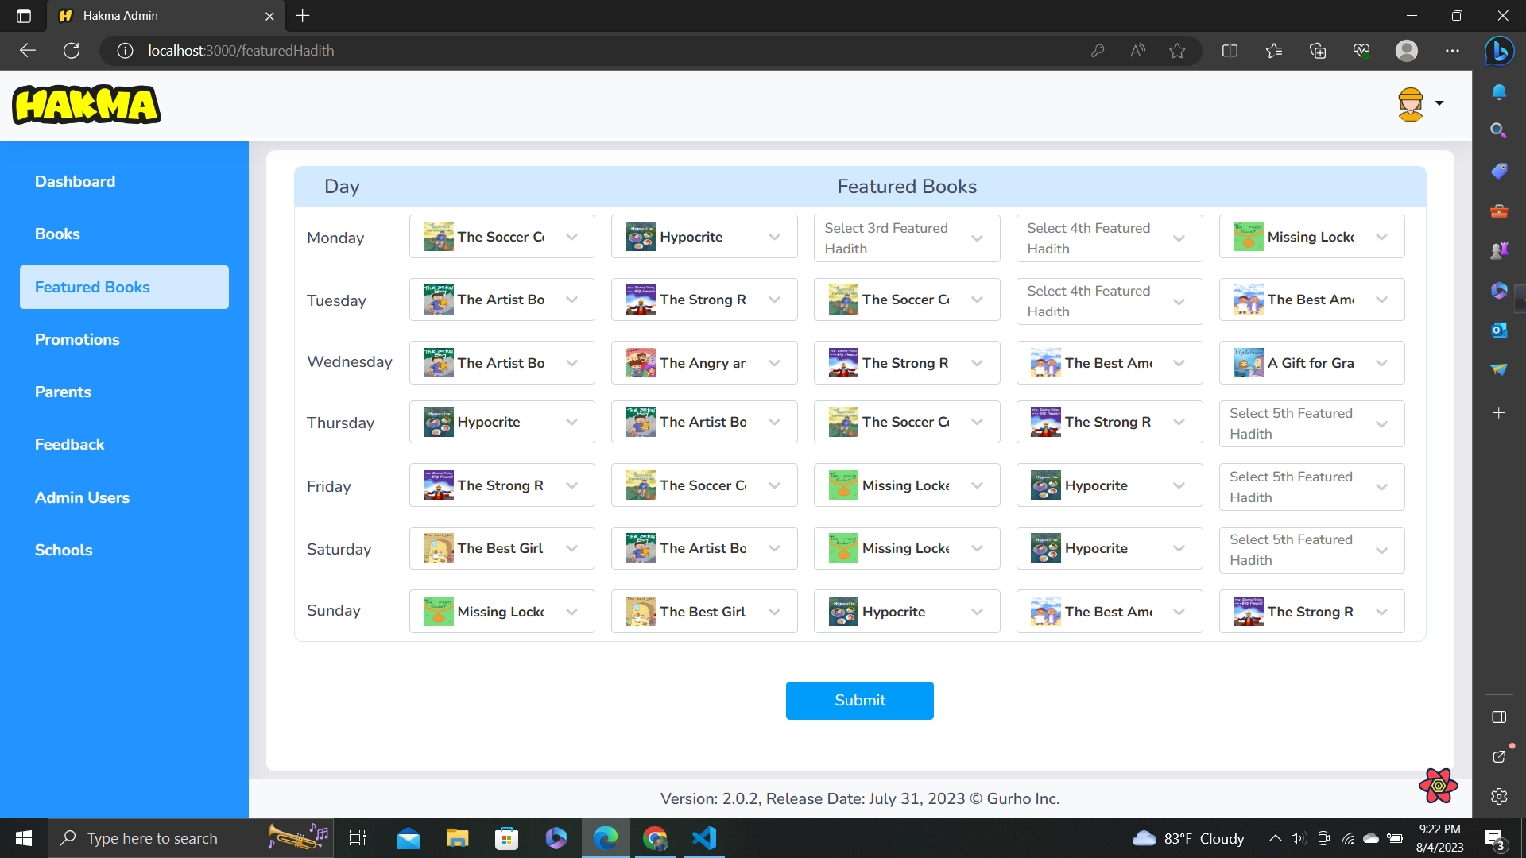
My Contributions
Implemented featured and promotional books that will show on the Hakma app
Implemented charts and cards in dashboard for data visualization

Slide 11
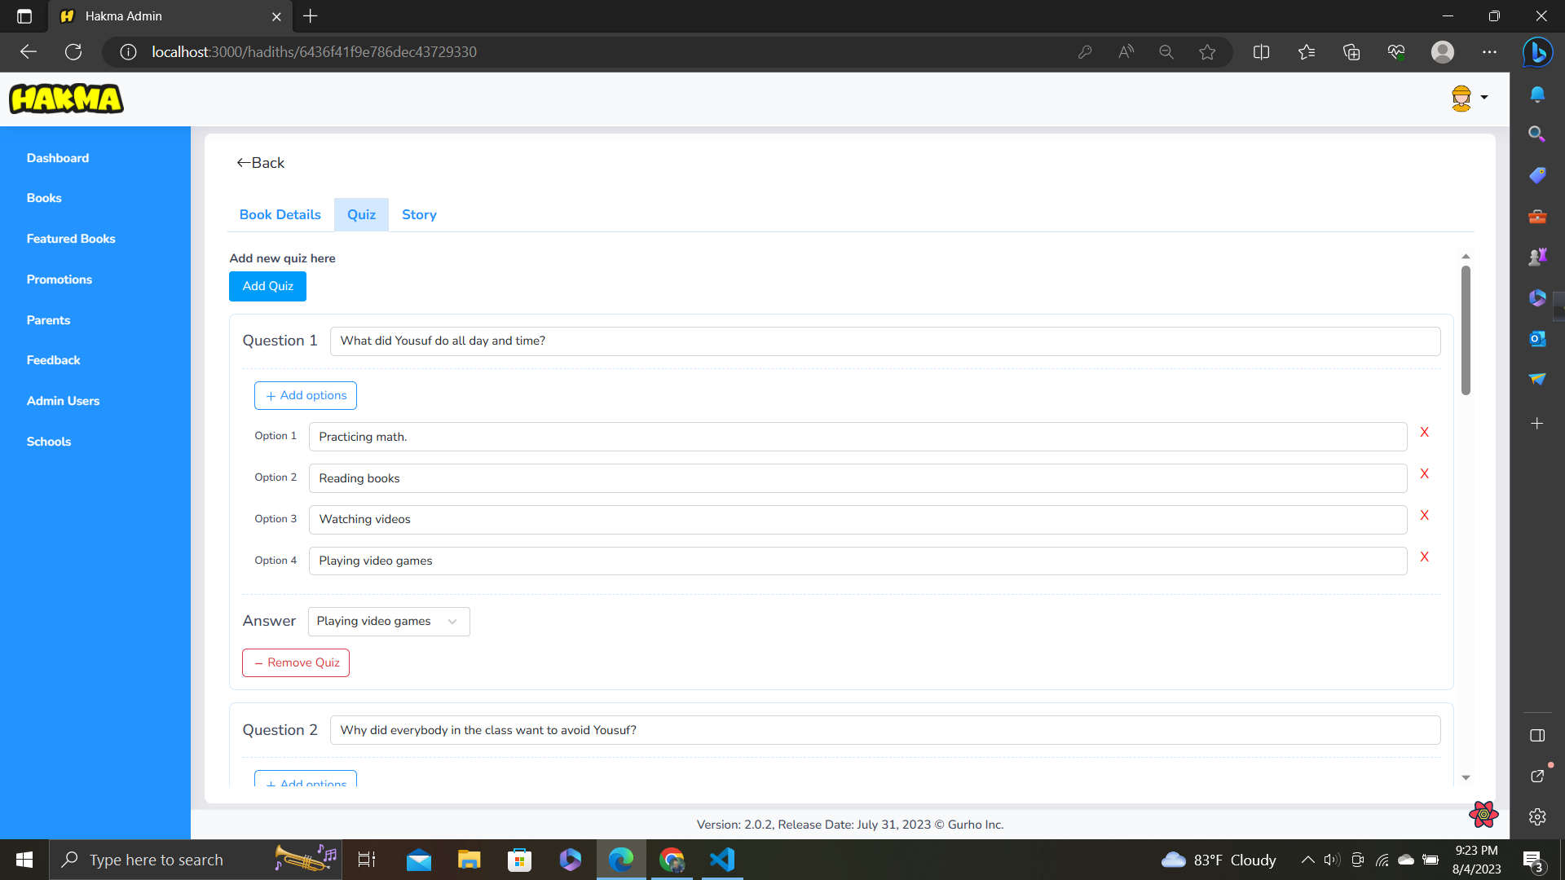
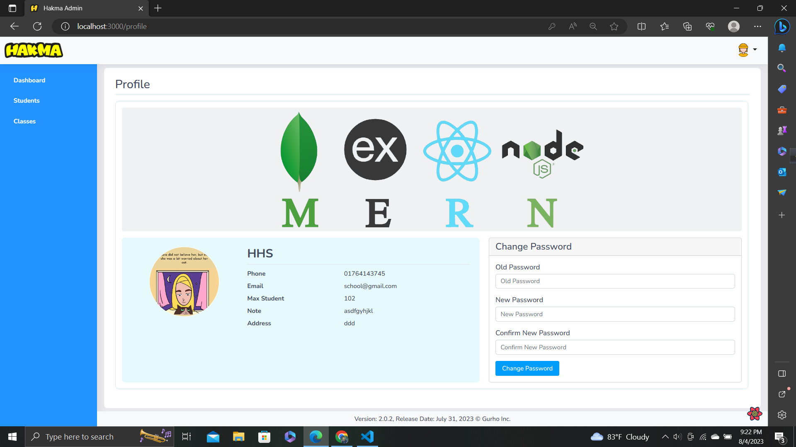
My Contributions
Data and form validation, filtering and searching
Integrate with backend using REST Architecture
Integrate Api hooks with React query

Slide 12
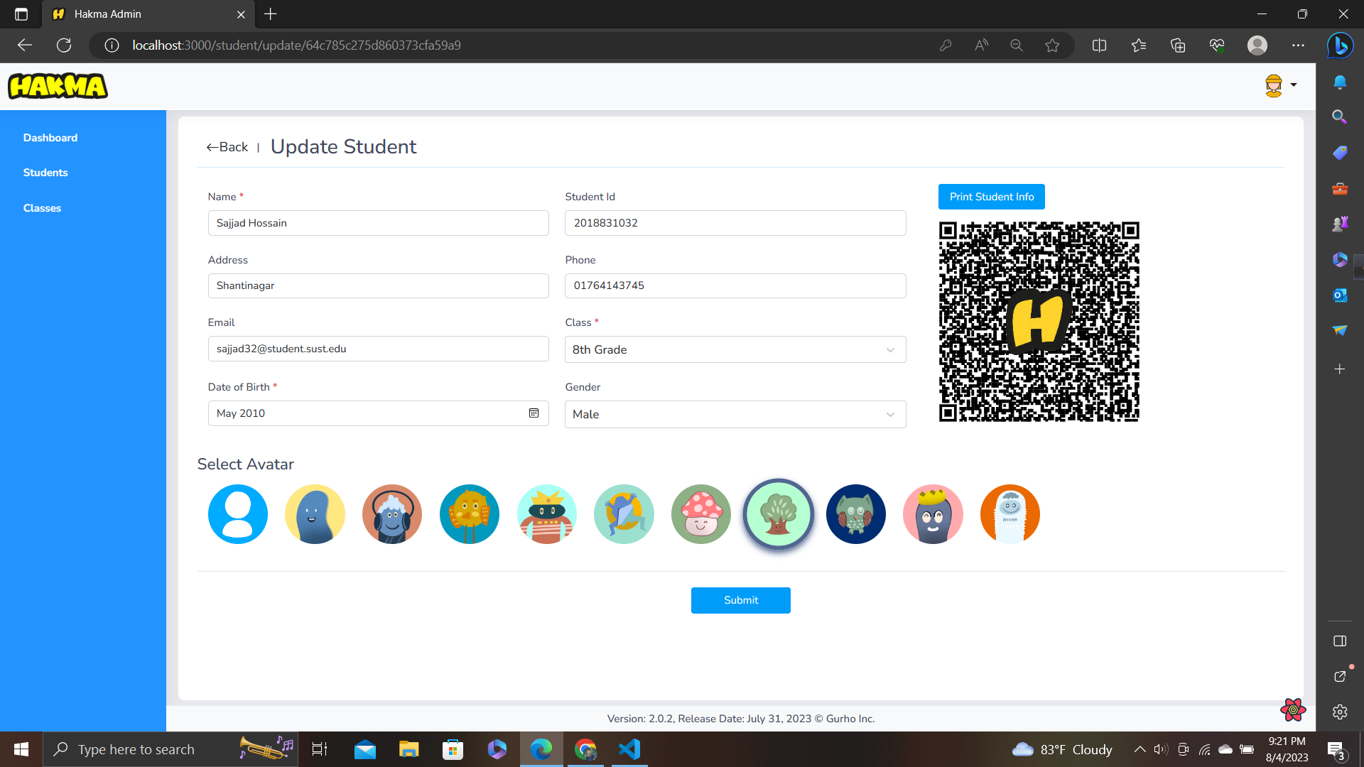
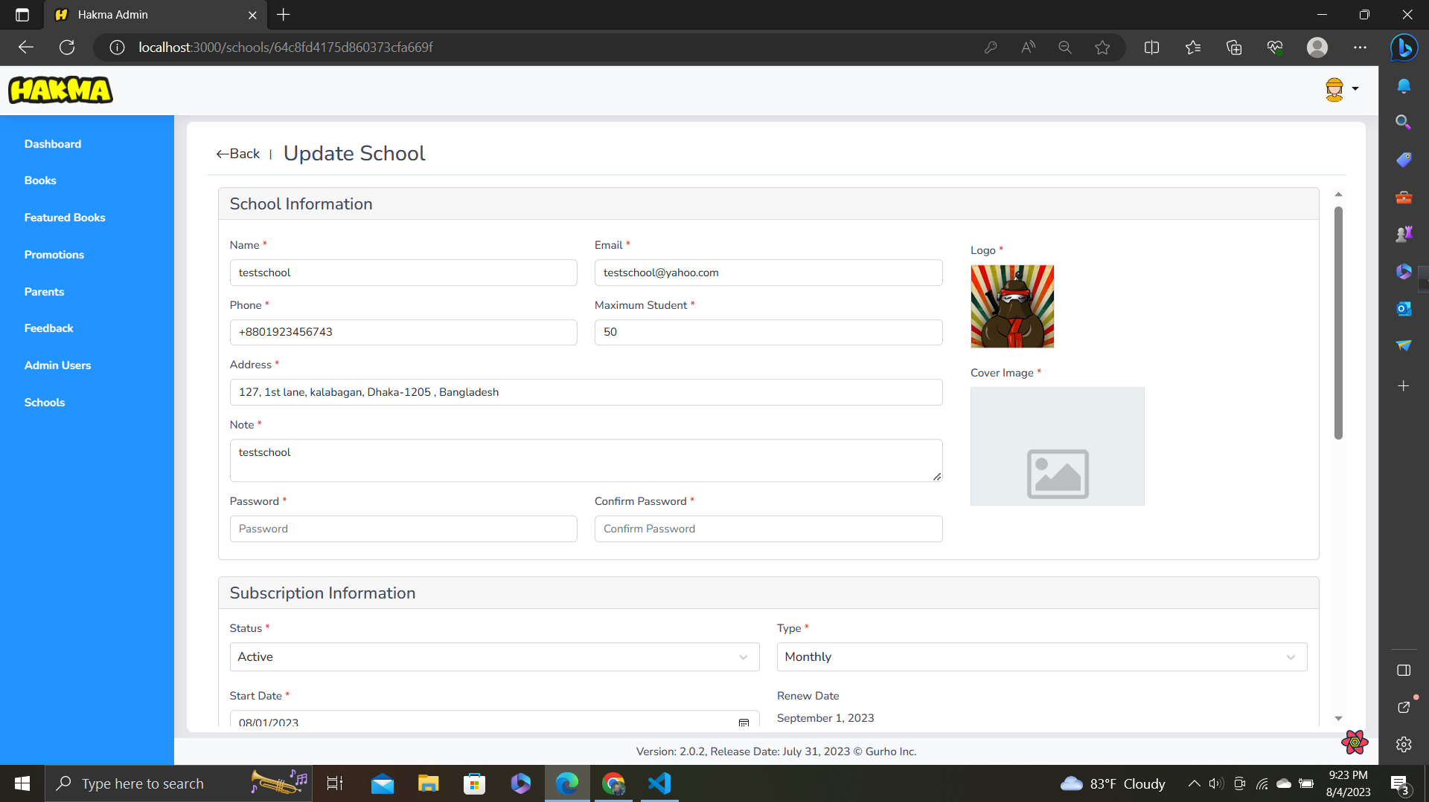
My Contributions
Generate and download QR code for student credentials
Create and update Stories, Quizzes, Schools, Classes, Students, Users and promotional books

Slide 13
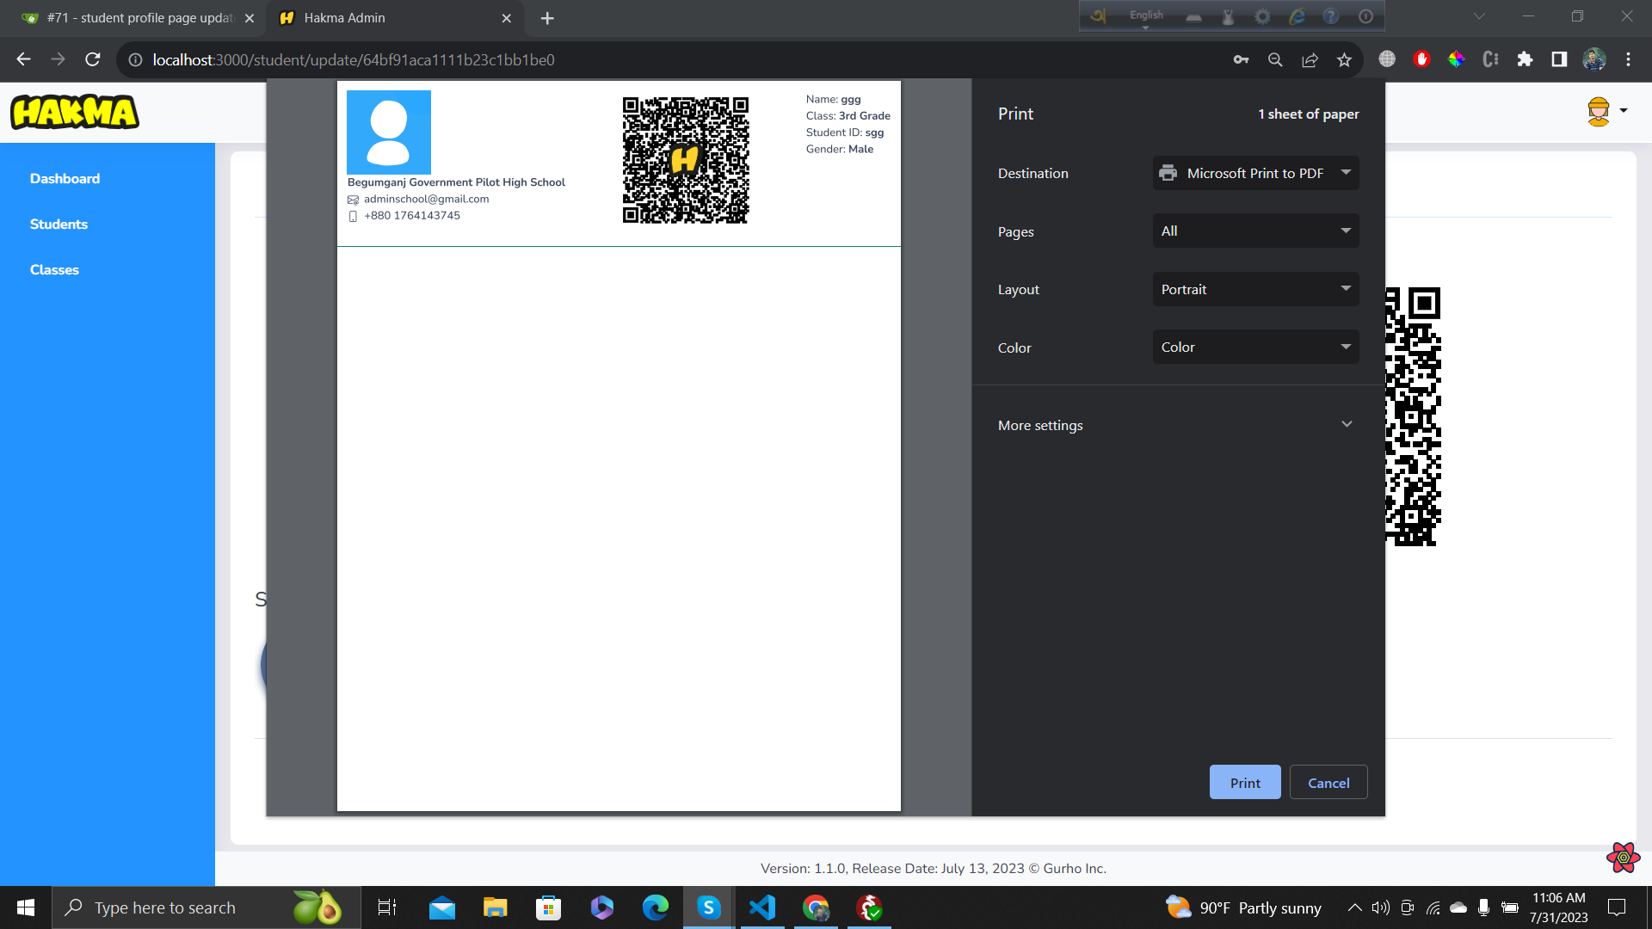
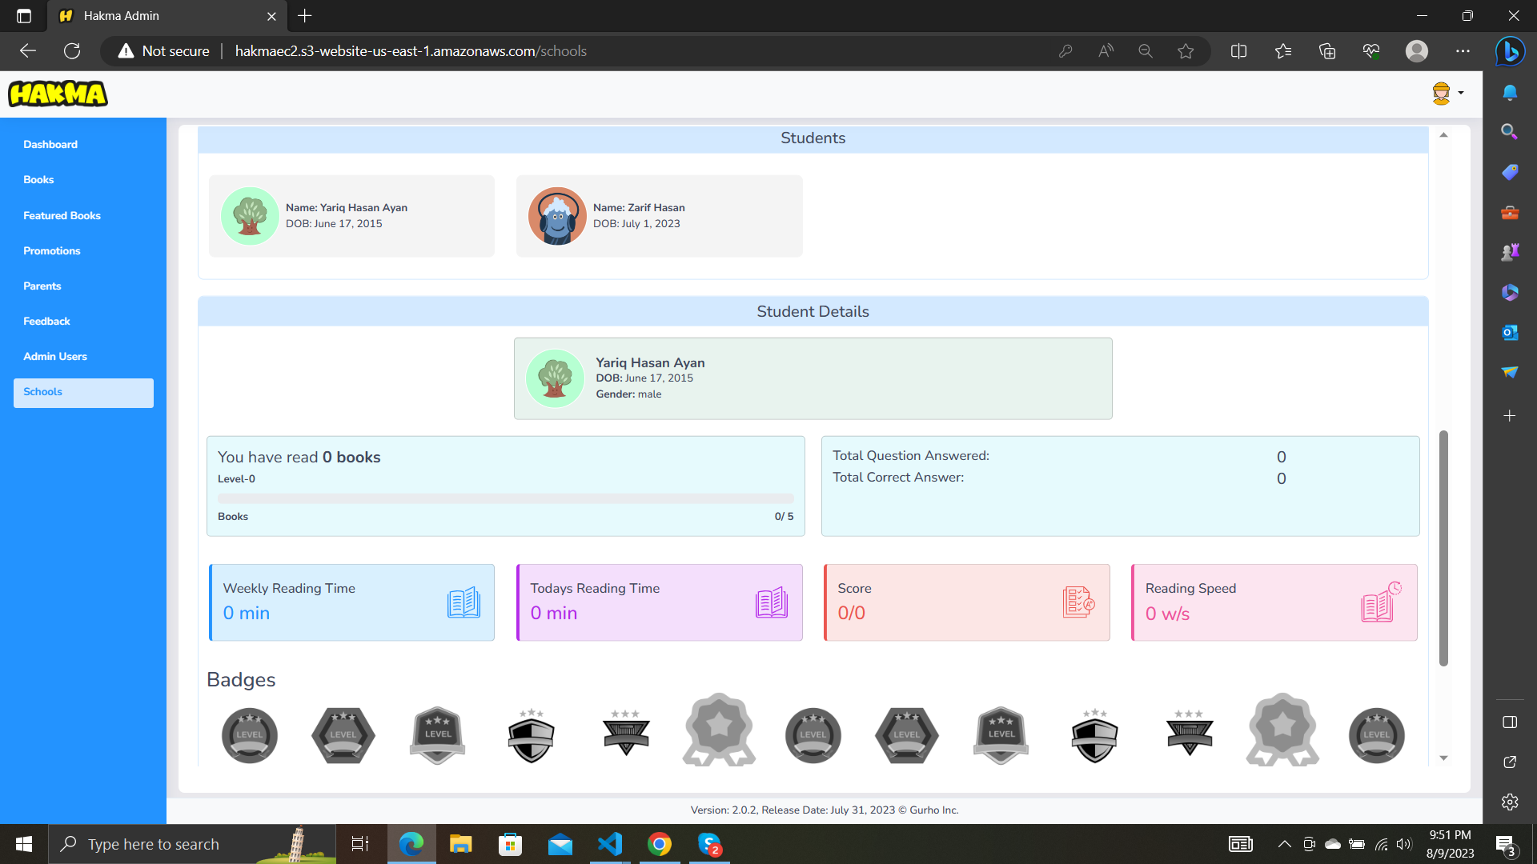
My Contributions
Generate and print PDF for students informations
Test, Refactor and Fix all features

Slide 14
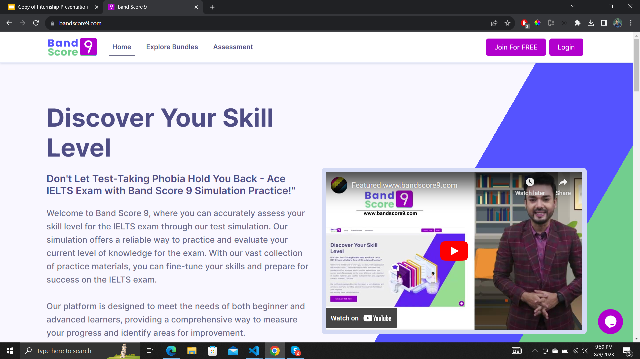
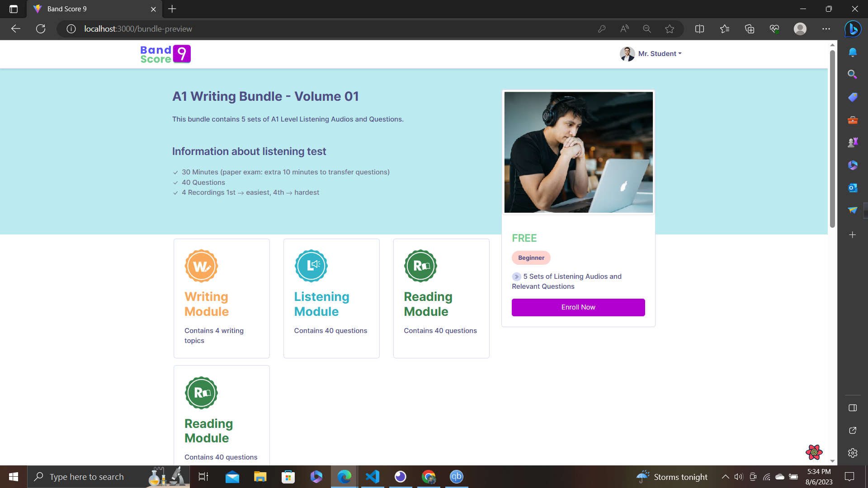
Band Score 9
A web application for simulating IELTS examination for students to give mock test for preparation

Slide 15
Features
Students
Can give test based on skill type and level
Can review test results after giving test
Can purchase bundle containing multiple test
Sign up with email, Google and facebook
Can give free assessment
Teachers
Create and update parts
check assessments
Auto generate test

Slide 16
Tools and Technologies

Slide 17
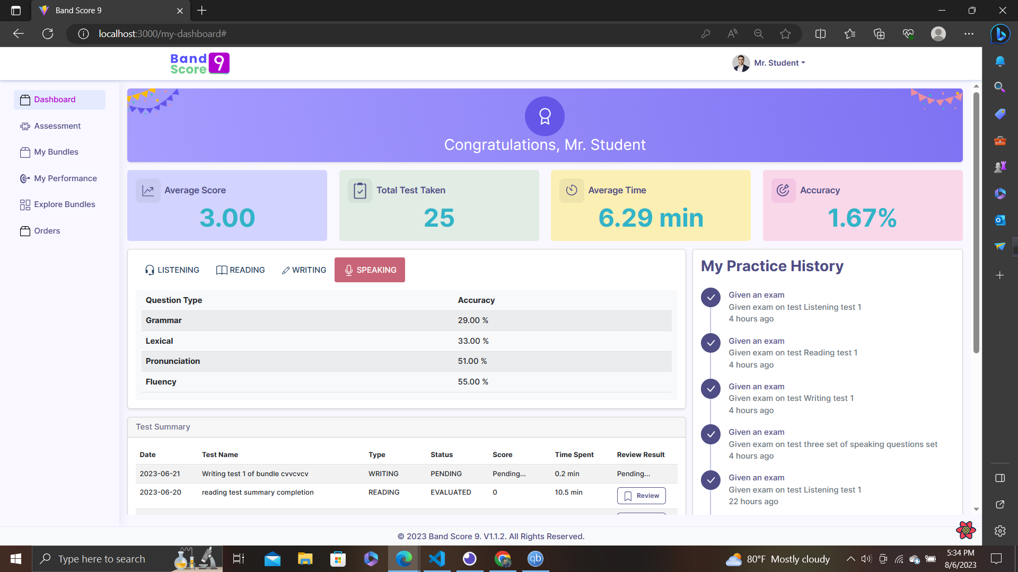
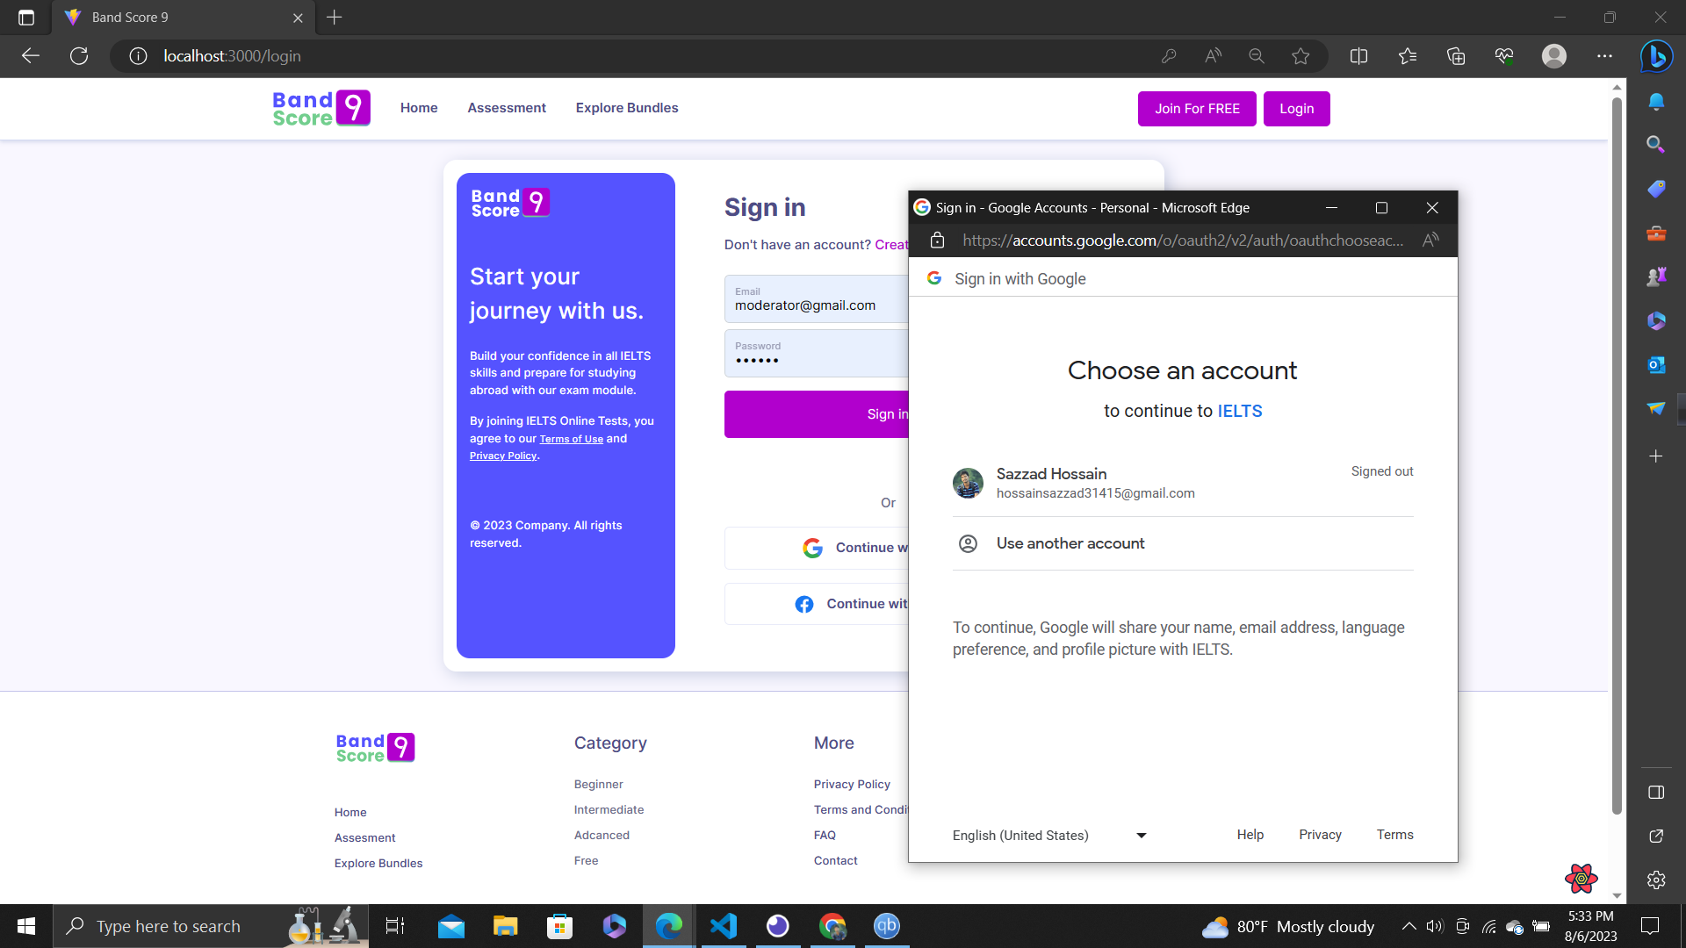
My Contributions
Implemented authentication with google and facebook
Implemented student dashboard and student test review pages.
Implemented drag and drop features

Slide 18
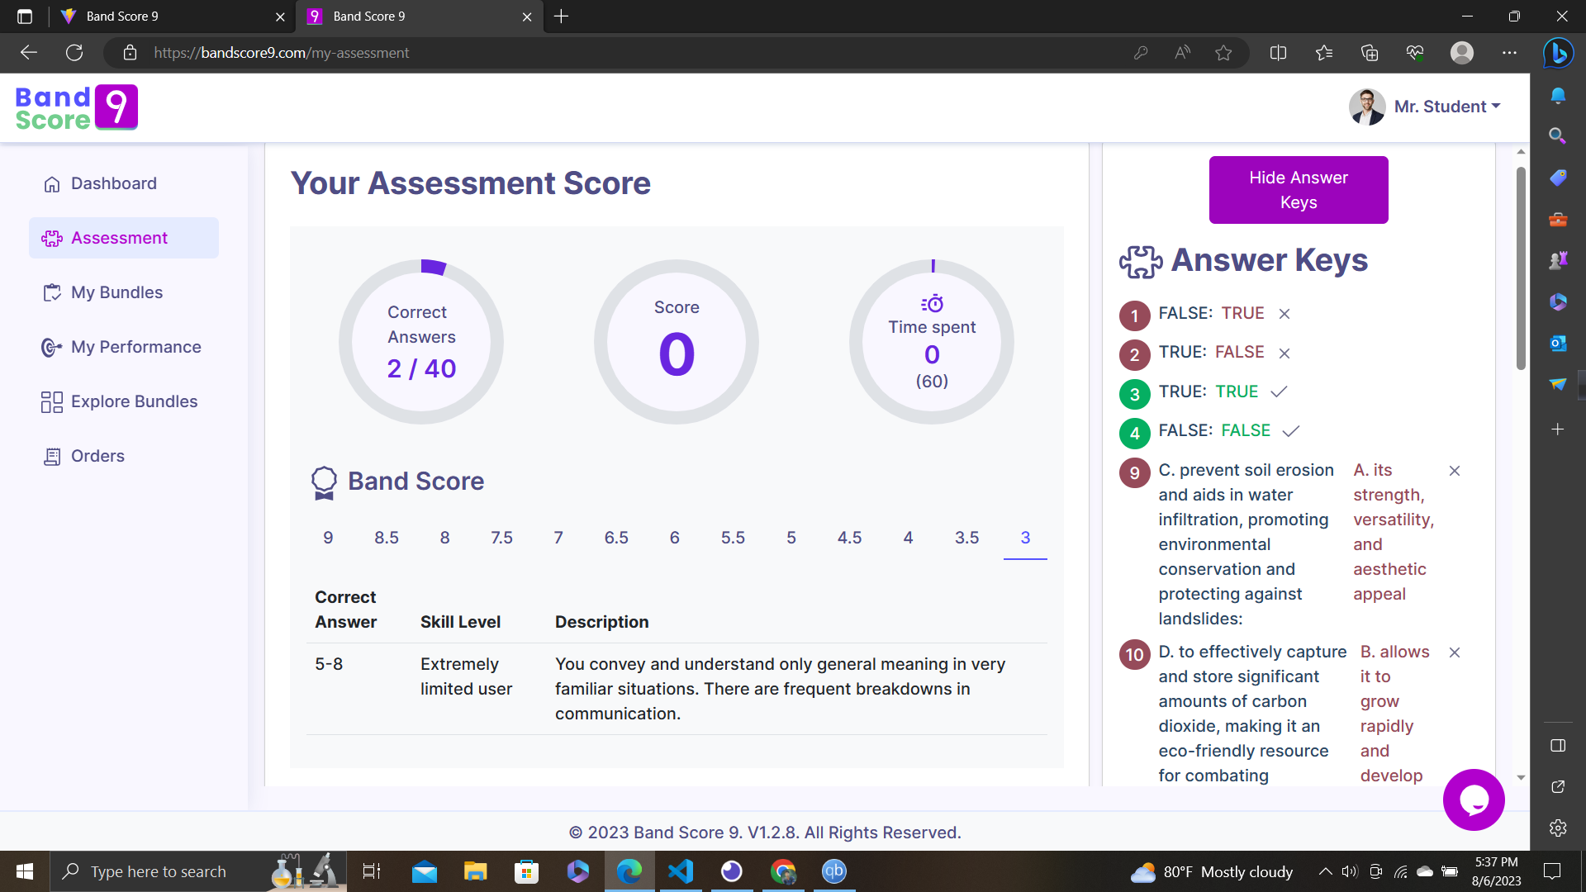
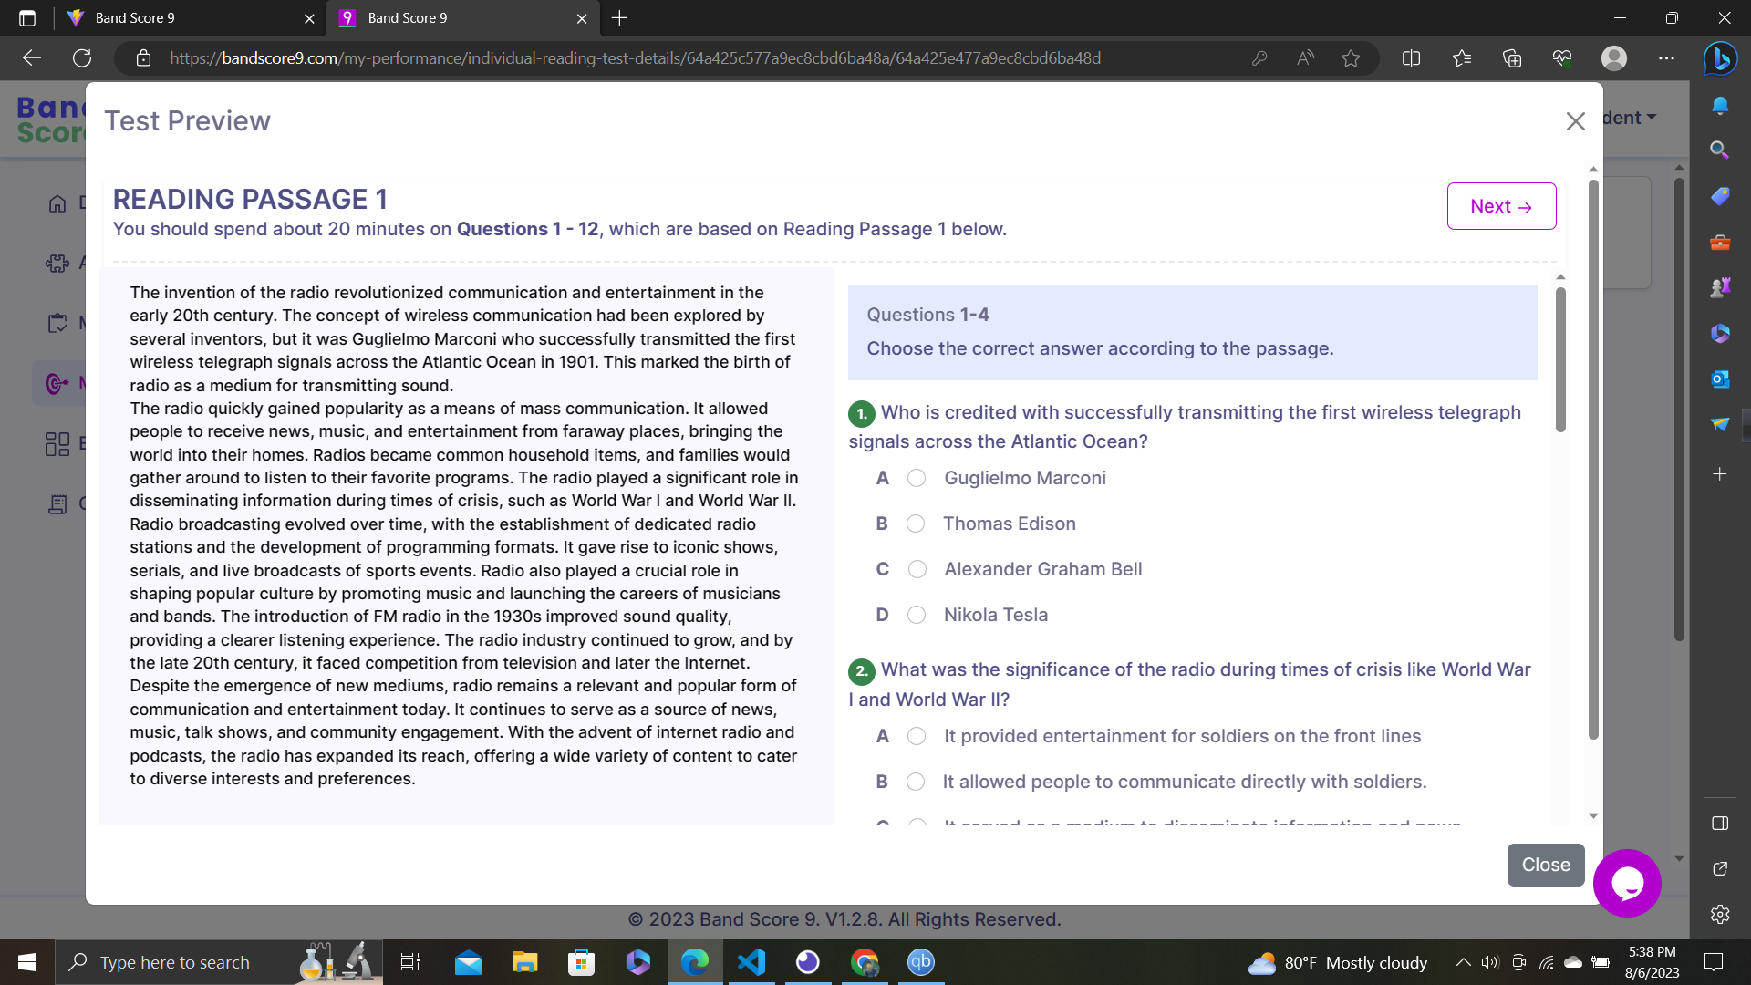
My Contributions
Basic CRUD functionality with React Query
Implemented student test review pages.
integrated reading and listening test modules

Slide 19
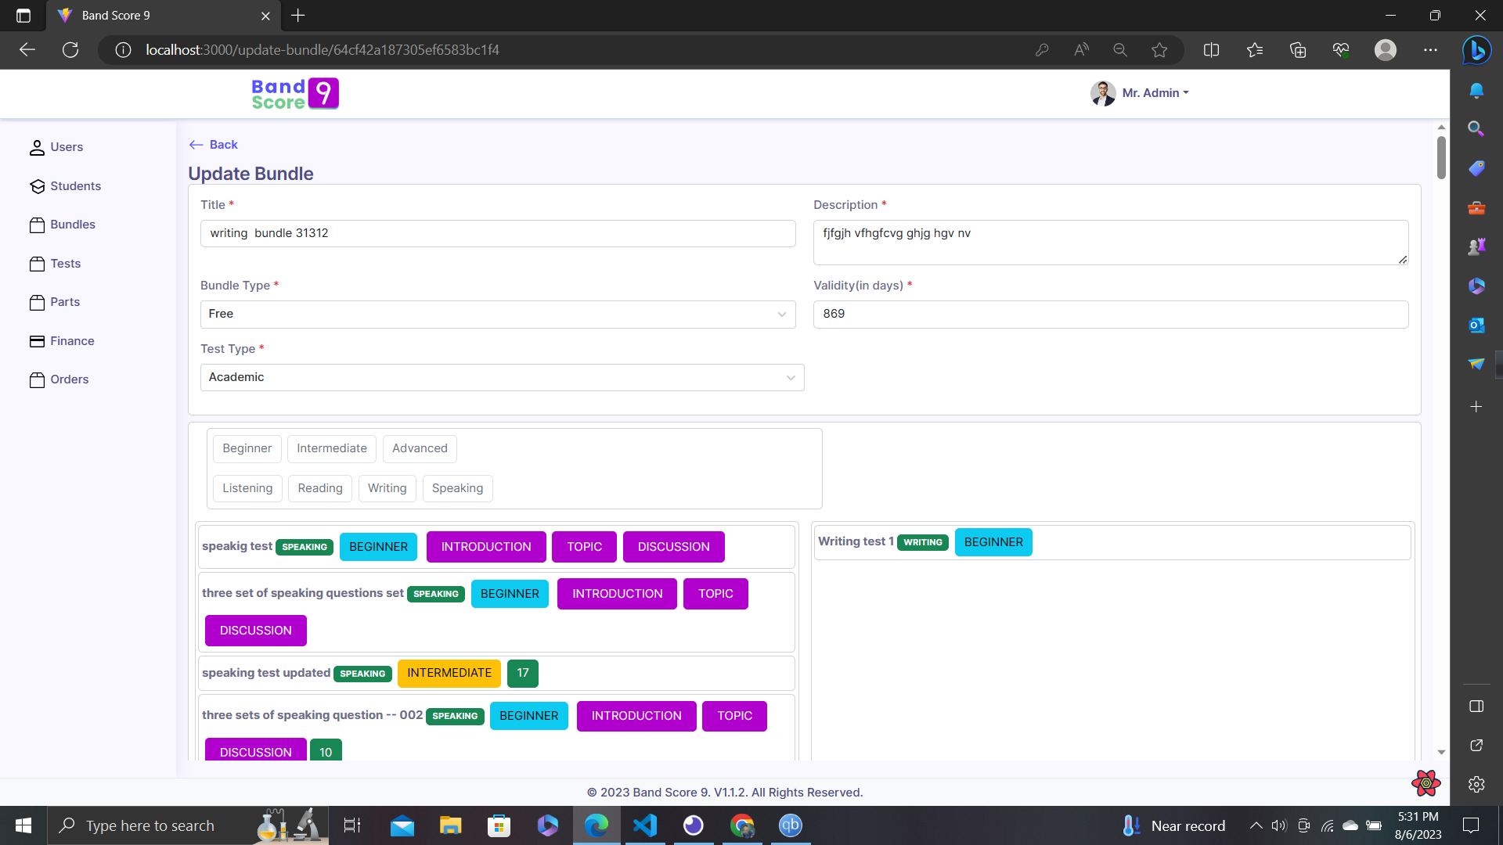
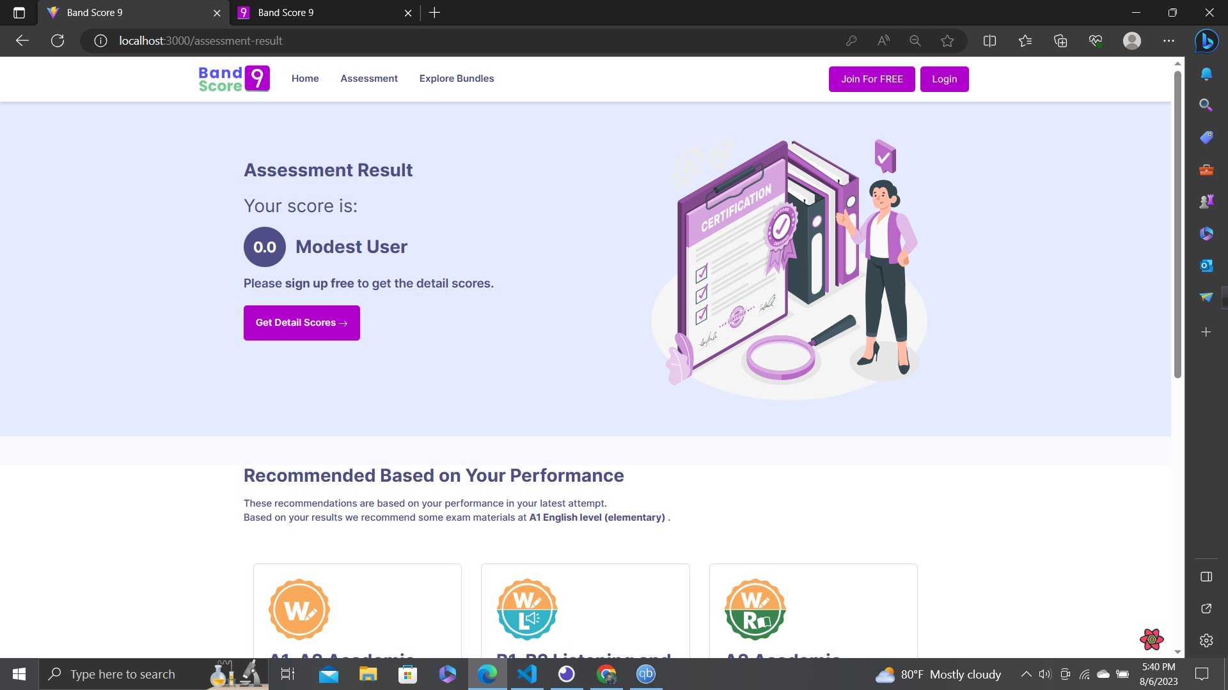
My Contributions
Implemented automated test generation
Integrate with backend using REST Architecture
Implemented filtering, pagination and searching
implemented the logic for free assessment

Slide 20
What did I learn

Slide 21
Technical Aspect
Typescript
ReactJS
Git
Bootstrap
React Query
Visual Studio Code
And many more…

Slide 22
Non-Technical Aspect
How to increase Code Quality
Professionalism
Team Work
Punctuality
Communication
Planning
Knowledge Sharing
And many more…

Slide 23
Thank You!
Questions Please…

